Slide 1
Using Artificial Intelligence Wisely: Age-Friendliness, ‘Snow Moles’ and Deep Mapping Urban Perception
Zhewen*, L., Sawada*^, M., Kristjansson**, E., Baxter**, D, Dignam M. **
*Laboratory for Applied Geomatics and GIS Science (LAGGISS), University of Ottawa, Department of Geography, Environment & Geomatics.
** Department of Psychology, University of Ottawa.
^ Corresponding author
Notes:
Hello everyone; I am very honoured to have this opportunity to share with you the project that I am working on. Our research topic is about “Using artificial intelligence wisely for deep mapping the urban perceptions of Age-friendliness.”

Slide 2

Backgrounds
WHO published a guide that demonstrated a key finding the need to consider older adults in urban design.
However, little research has been published linking age-friendly communities as a whole with the well-being of older residents.
https://www.who.int/publications/i/item/9789241547307
Notes:
The World Health Organization has identified the need to consider older adults in urban design as a key finding of its work on Age-Friendly Cities. This was based on data from focus groups conducted in 33 cities around the world. However, despite this important finding, little research has been published linking age-friendly communities as a whole with the well-being of older residents.

Slide 3
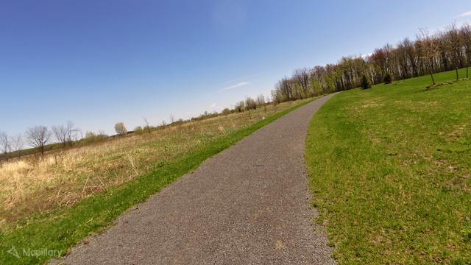
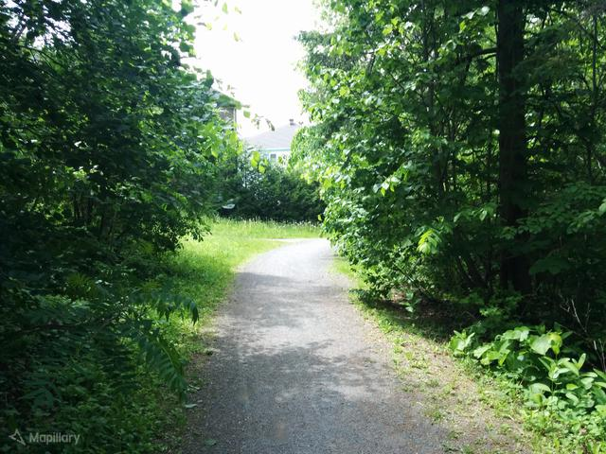
Backgrounds
Dr. Kristjansson’s team derived the baseline measures
Greenspace(summer scenery) and Whitespace(winter scenery)
Focusing on assessing the age-friendly greenspace
Utilizing the street images
Image samples
Notes:
Several years ago, Dr. Kristjansson and her team at the University of Ottawa conducted relevant research on age-friendly communities. They found that greenspace and whitespace were two key measures influencing age-friendliness and well-being. Their study was carried out in eight cities across Canada. Building upon their work, we have focused our research on the assessment of greenspaces in Ottawa, using street view images photographed in the summertime for greenspace quality assessment.

Slide 4



Backgrounds
Four perceptual dimensions for greenspaces assessment
In which environment would you feel a stronger connection to nature?
Which environment do you find more beautiful or appealing?
VS
In which environment would you feel safest?
In which environment do you feel you would best be able to do the activities you enjoy?
~10,000+ imagery dataset
Notes:
We have done previous work on collecting the data by collaborating with a volunteer group called 'Snow Mole' from Ottawa. We together established four perceptual dimensions of greenspace quality based on four questions: "In which environment do you think has a strong connection to nature?", "Which environment do you find more beautiful or appealing?", "In which environment would you feel safest?" and "In which environment do you feel you would best be able to do the activities?". Over 10,000 street images have been rated for each question in the form of random pair duel.

Slide 5
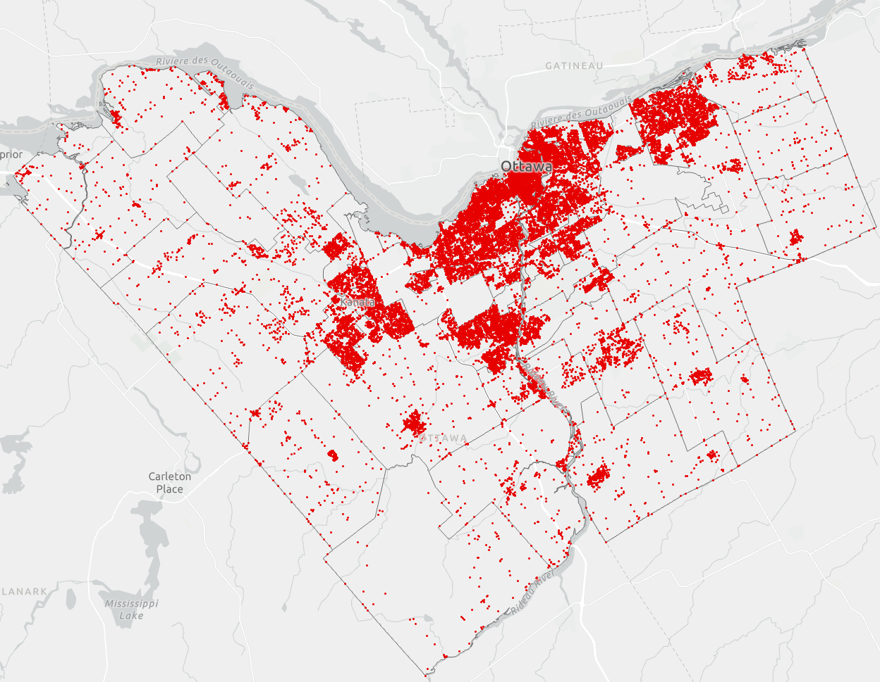
Backgrounds
Purpose & Challenges
Purpose:
to produce detailed maps of the qualitative characteristics of age-friendliness
Predicted location in Ottawa
Challenges:
Large number of images require ranking
Manual assessment and ranking impracticable
Requires training hundreds of people
~20,000+ street images
Notes:
Our aim is to create detailed maps across Ottawa, with each street and park ranked along each age-friendly dimension. However, given the large number of images to be predicted, it is impracticable to ask people to assess and rank them manually, as this would require us to train hundreds of people capable of completing such a task.

Slide 6
Backgrounds
Leveraging Deep Learning Approach
Solution:
We demonstrate the use of convolutional neural networks (CNN) in computer vision to map perceptual constructs related to outdoor greenspaces.
Data
Deep
Learning
Rules
Labels/Numbers
Notes:
Therefore, we have developed an approach using a convolutional neural network, a popular method in computer vision for mapping perceptual constructs associated with street images.

Slide 7

Data collection
Methodology
In which environment would you feel a stronger connection to nature?
Image duel
left
right
no preference
Image Left | Image Right | Label
Xi | Xj | Right
Notes:
During our data collection process, participants sit in front of a computer and are presented with a web page displaying two images side-by-side. They then choose either the left or right image based on a qualitative question, such as which one exhibits a stronger connection to nature. We only record the identifier of the chosen images and the winner of the comparison in tables.

Slide 8
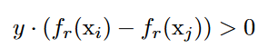
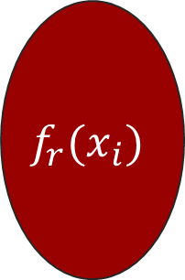
Problem Formulation
Methodology
Image Left | Image Right | Label
X1 | X3 | Left
X2 | X3 | Right
… | … | …
$$f_{r}(x_{i})$$
Image | Score
X1 | 1.04
X2 | 0.85
X3 | 0.93
~5000+ triplets for each dimension
Train a ranking model to satisfy the restrictions of RankSVM
X1
>
X3
>
X2
X1 | X3 | Left
X2 | X3 | Right
Notes:
Our dataset comprises of over 5,000 records of pairwise comparison for each perceptual dimension. Our aim is not just to identify the winner of each duel, but to create maps that exhibit the qualitative characteristics of age-friendliness. Hence, we strive to find a ranking function or model that can quantify the duel results. To achieve this, we have formulated our questions in accordance with the RankSVM constraint, which is a well-established algorithm that transforms a ranking learning problem into an optimization problem with a set of constraints.

Slide 9
Methodology
Dataset description
Splitting the data into three subsets for each dimension
Training set
Validation set
Test set
60%
20%
20%
Used for model training
Used for assessing model accuracy and generalization ability
Ensuring the validity of the method
Notes:
To ensure the validity of our method, we have partitioned our dataset into three subsets for each dimension: a training set for training the neural network, a validation set for evaluating the prediction performance and adjusting model hyperparameters as needed, and a test set that is never seen during the model training process and is only used once to independently assess the model's accuracy.

Slide 10
Methodology
Model Architecture Design
Step 1: Learning ranking knowledge using Siamese CNN
Image Left
Ranking Score (Left)
Feature Extraction
Subnetwork
Output
Feature Extraction
Ranking Score (Right)
Learn knowledge for ranking
Image Right
Notes:
Our approach involves designing a model that learns to rank the training data using a Siamese CNN architecture. The model consists of two identical, disjoint branches that extract visual semantic features from the two images in a pair. These feature extractor layers are then concatenated and followed by a subnetwork that learns the ranking knowledge. Finally, the model outputs the ranking score of the two input images.

Slide 11
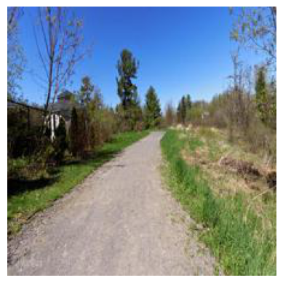
Methodology
Model Architecture Design
Step 2: Predicting new data using the trained model
Feature extraction
Subnetwork
Tied weights
Feature extraction
Identical
architecture & weights
New image
Subnetwork
Feature extraction
Ranking Score
Single input ranking scoring model for prediction
Notes:
Once the model is well-trained, we build another ranking scoring model for a single input using the same feature extraction and the subnetwork architecture with identical trained weights. We then use this ranking scoring model to predict new data.

Slide 12
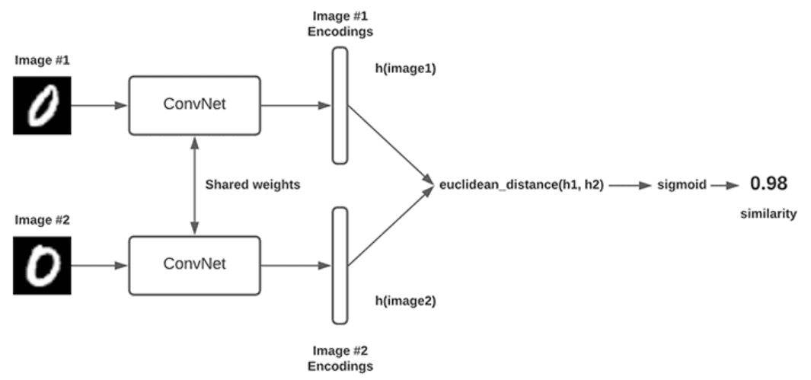
Methodology
Siamese Convolutional Network
Identical branches
Image, video or text similarity
https://pyimagesearch.com/2020/11/30/siamese-networks-with-keras-tensorflow-and-deep-learning/
Notes:
A Siamese Neural Network is a powerful tool for learning joint feature representations in a wide range of applications, such as image, video or text similarity. This type of network has two identical branches with the same configuration, parameters and weights, and the parameter updating is mirrored across both subnetworks. Therefore, we think it is ideally adapted to our problem formulation

Slide 13
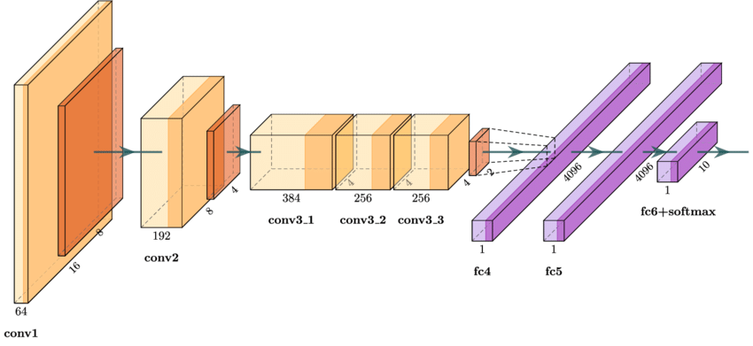

Methodology
Feature Extraction in each branch
Famous CNN Backbones: AlexNet, Xception, VGGNet, etc
AlexNet architecture
VGGNet19 architecture
https://www.researchgate.net/figure/AlexNet-architecture-used-as-the-baseline-model-for-the-analysis-of-results-on-the_fig5_339756908
https://viso.ai/deep-learning/vgg-very-deep-convolutional-networks/
Notes:
The process of feature extraction is critical in image analysis, as it allows for the conversion of raw image data into multi-level representations that can be used for a variety of tasks. Convolutional neural networks have proven particularly effective for this purpose, as they can automatically learn complex features in images. In our research, we experimented with several open-source CNN backbone that have demonstrated remarkable performance on classification tasks on the ImageNet dataset, which is a dataset with over one million images. The backbones we chose include AlexNet, Xception, VGGNet and others.

Slide 14
Methodology
Feature Extraction in each branch
Using transfer learning technique
Fine-tuning the last four convolutional layers
Unfrozen layers
Frozen layers
Initializing with the weights pre-trained on the classification (1,000 classes) of ImageNet (a dataset of over one million images)
Notes:
However, due to the small dataset we collected, there is a risk of overfitting and weak-generalizing ability. To mitigate these risks, we employed a transfer learning technique for the backbone. Specifically, we initialized the weights with pre-trained parameters on the ImageNet dataset. Additionally, we made slight adjustments to the last several layers of the network to ensure its relevance to our problems and datasets at hand.

Slide 15
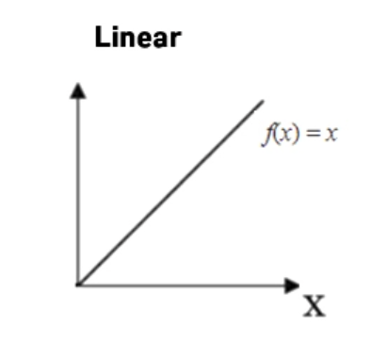
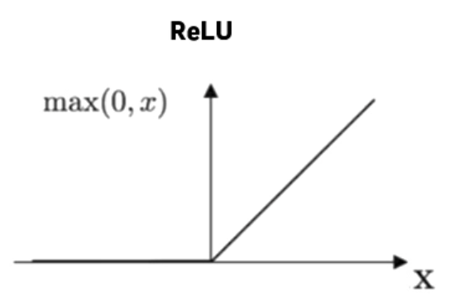
Methodology
Subnetwork Baseline Design
Ranking score output activated by ‘linear’
Flattened layer
of features extracted
Fully connected layers
activated by ‘ReLU’
Notes:
To model the ranking function, we have designed a subnetwork that consists of a sequential layer group of fully connected layers. In detail, the neurons in each layer are activated by the ReLU function and the last output layer is activated by a simple linear function to yield ranking scores.

Slide 16
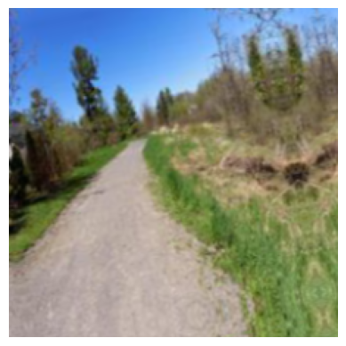
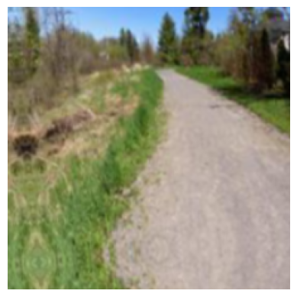
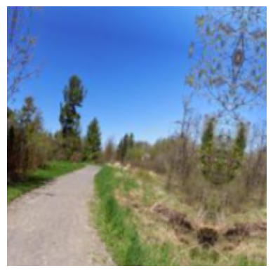
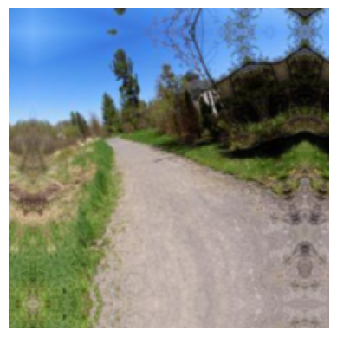
Methodology
Model Optimization
Data augmentation
random seed to generate the modified data
Original
Translation
Flip
Rotation
Zoom
Notes:
To better leverage limited data, we employed four types of data augmentation techniques, including translation, flipping, rotation, and zoom. Translation involved shifting the image in different directions, while flipping involved horizontally flipping the image. Rotation entailed rotating the image by a certain degree, and zooming involved scaling the image. To ensure that our augmentation was performed consistently, we utilized a random seed to generate the modified data.

Slide 17
Methodology
Model Optimization
Hyperparameter tuning for each perceptual dimension
Different combinations of
Feature extraction backbones
Units and depth of the fully connected layers in the subnetwork
Drop out some neurons in the subnetwork
Optimizers (Bayesian or grid search) and learning rates
……
Model Evaluation
Baseline Model Selection
Hyperparameter
Tuning
Notes:
Hyperparameter tuning is another important means to optimize the model performance. In our study, we have thoroughly tuned various hyperparameters to ensure that our model performs at its best. We have experimented with different CNN backbones, fully connected layer configurations, activation functions, dropout rates, optimizers, learning rates, and more. Through a systematic process of trial and error, we were able to find the optimal combination of hyperparameters that produced the best results on the validation sets.

Slide 18
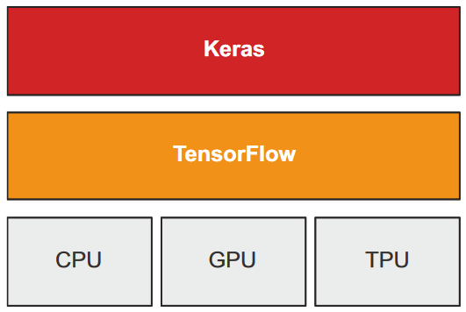
Methodology
Model Implementation
Using Keras API
Deep learning API on TensorFlow
Enabling fast experimentation
End-to-end, open-source machine learning platform
Nvidia’s CUDA and cuDNN to implement GPU accelerated computing
Chollet, F. (2021). Deep learning with Python (Second edition).
Using KerasTuner for hyperparameter optimization
Model trained on Nvidia GTX 1080
Notes:
Our model is implemented using the Keras API, an open-source deep learning API built on top of TensorFlow that enables efficient experimentation. We leverage the computational power of an Nvidia GTX 1080 GPU, which is capable of accelerating computations with the support of CUDA and cuDNN frameworks, for efficient model training.

Slide 19
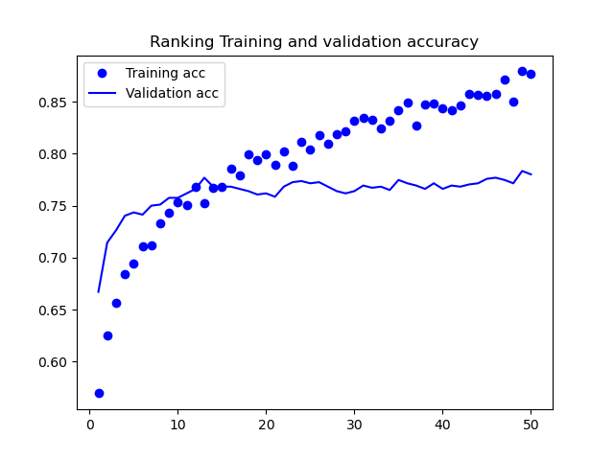
Preliminary Results
“Connection to nature” ranking model performance
Training Accuracy | 75.1%
Validation accuracy | 77.5%
Test accuracy | 78.3%
Get the best model weights from the best model checkpoint callbacks
Notes:
We are pleased to report that we have obtained promising preliminary results from our training on the ‘Connection to nature’ dimension. Although overfitting is a concern since the gap between training and validation accuracy is increasing, the model performance is generally satisfactory if we stop at the epoch when the highest validation accuracy occurs. As shown in the slide, our ranking model has achieved a training accuracy of 75.1% and a validation accuracy of 77.5%. Moreover, the model's test accuracy is even higher at 78.3%, indicating that the model has a good generalization ability.

Slide 20

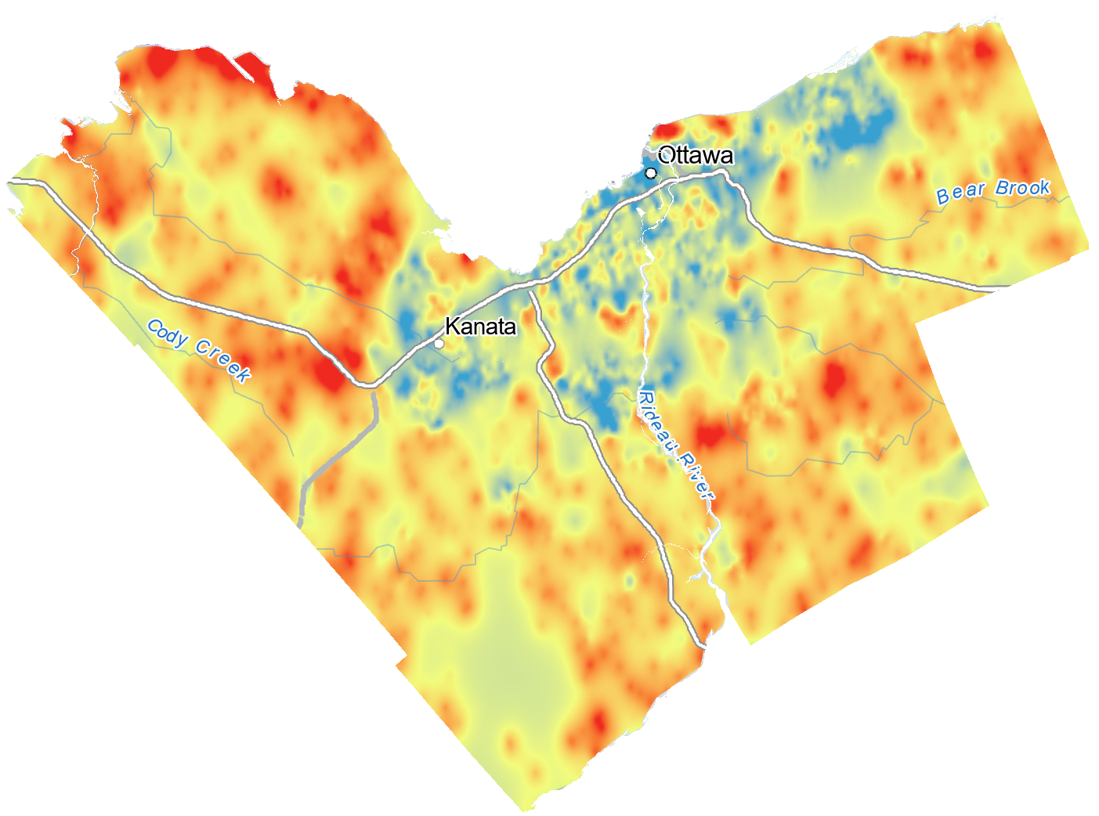
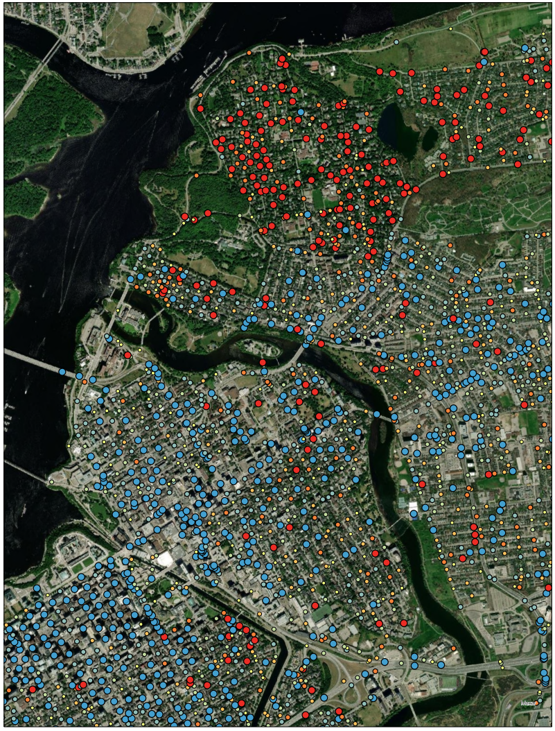
Preliminary Results
Ranking scores distribution
“Connection to nature” ranking model prediction
L
H
Kriging Interpolation
Notes:
Subsequently, we applied our trained model to predict the ranking scores of new images in Ottawa, and we constructed an interpolation map for evaluation purposes. The map depicts areas that convey a strong sense of ‘connection to nature’ in blue, while areas that do not in red. Notably, the blue regions tend to correspond to areas with lower vegetation cover and higher human-made structures. Upon closer examination of a specific area in the downtown region on the right, we found that the high predicted ranking score areas that are colored red and the low predicted ranking score areas that are colored blue are consistent with our visual analysis of the results from the satellite background.

Slide 21
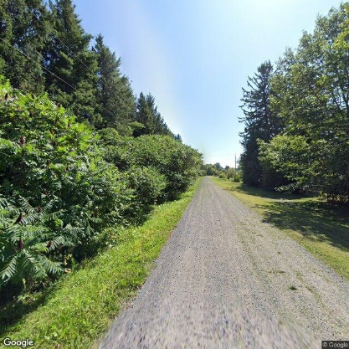
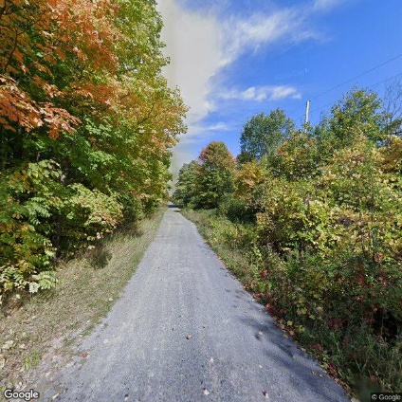
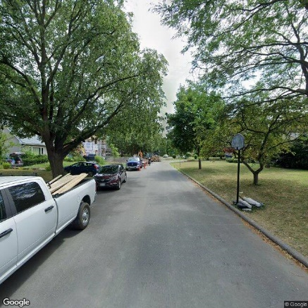
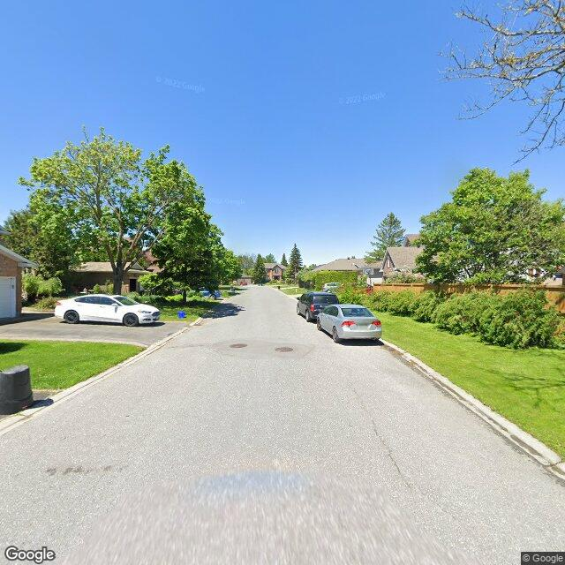
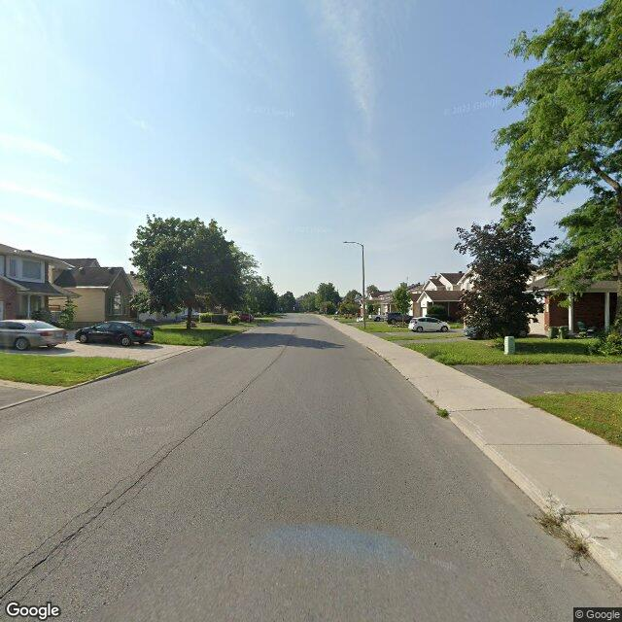
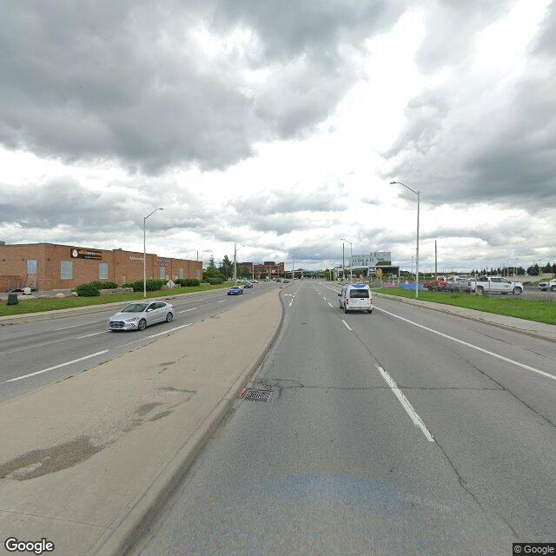
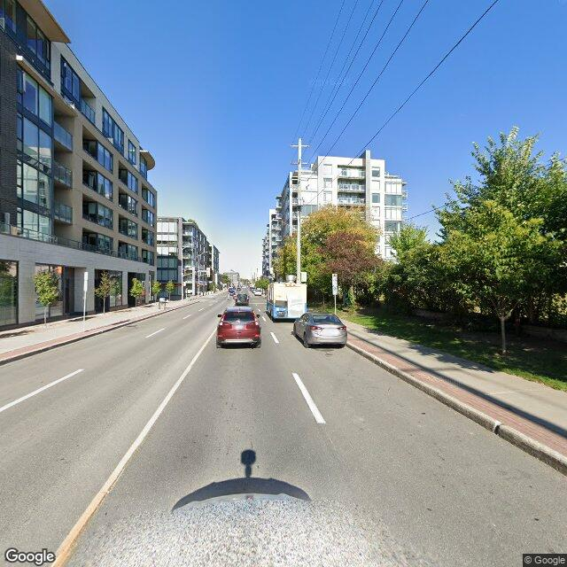
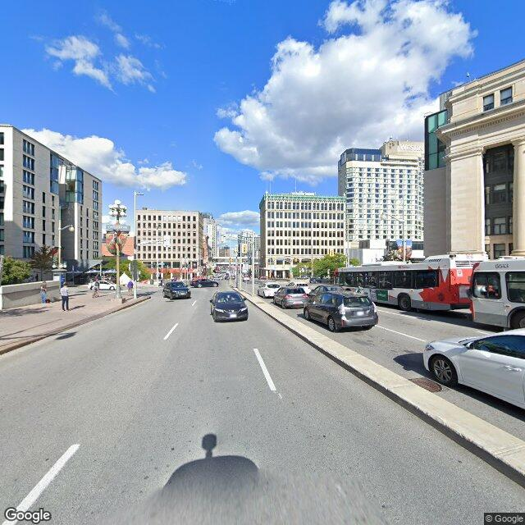
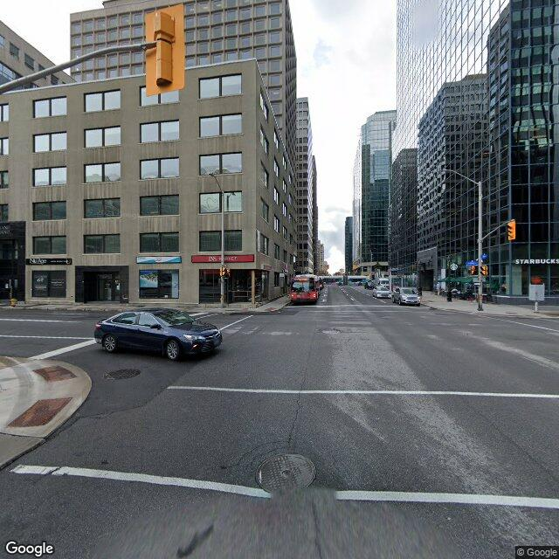
Preliminary Results
More sense of ‘connection to nature’
-1.43
0.1
1.3
2.3
3.2
4.4
Image-level evaluation
7.3
6.1
5.2
Less sense of ‘connection to nature’
Notes:
Furthermore, we conducted an image-level evaluation of our model's performance. We performed a visual comparison of the model's predicted ranking scores with the selected images, as shown in the slide. The comparison confirmed that the model's performance was indeed satisfactory, as the predicted scores aligned well with human perception.

Slide 22
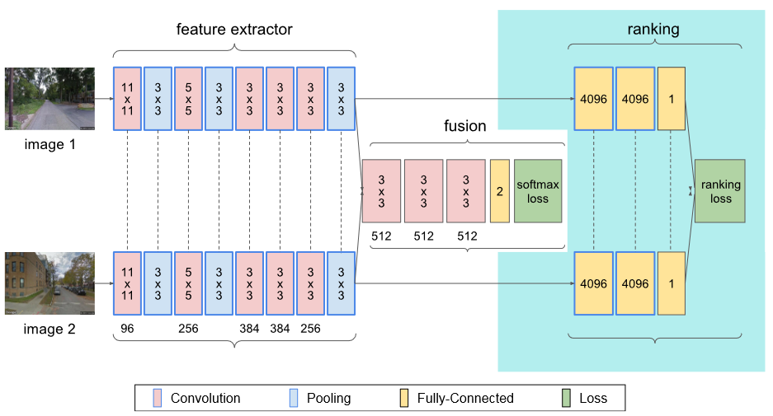
Discussion & Future Work
Issues to be optimized and to be resolved ：
Decreasing overfitting
Increasing prediction accuracy
Combining pairwise comparison prediction model for joint training
An approach proposed by Dubey et al (2016)
Loss = λ*Ranking Loss + Classification Loss
Notes:
Our study is still in its early stages, and there are several issues we need to address to improve the model's accuracy and reduce overfitting. In reference to existing literature, one approach that has shown promise is the combination of building a pairwise comparison model and a ranking model simultaneously for joint training, as proposed by Dubey et al in 2016. We plan to adopt this approach in our research to see if it improves our prediction accuracy.

Slide 23
Discussion & Future Work
Across different perceptual dimensions
Adopting transfer learning technique furthermore
Feature extraction
Subnetwork for
‘Connection to nature’
Knowledge (weights) learnt from
‘connection to nature’
Feature extraction
Subnetwork for
‘Safety’
Fine-tuning the last layers
Notes:
Moving forward, we intend to train models for the three remaining perceptual dimensions. One technique we will consider is transfer learning across different dimensions. For instance, we may transfer the weights learned from the 'Connection to Nature' ranking model to the 'Safety' ranking model, which we presume could potentially yield higher accuracy than just using the weights pre-trained on ImageNet alone.

Slide 24
Notes:
Thank you for your listening.

